Slide 1
Ideal Places to Work Segmenting and Clustering Universities in Manhattan
Ryan Brown
February 17, 2020

Slide 2
Nearby venues in Manhattan
Manhattan is home to many universities
Not all of the universities’ surrounding neighborhoods are alike
Not all people applying to administrative positions at these universities are familiar with the venues that are within walking distance of the campus gates

Slide 3
Goal
Identify the universities that share similar neighborhood venue categories by partitioning them into groups with similar characteristics

Slide 4
Data
21 universities
Longitudinal and latitudinal coordinates from Google Map
Nearby venues (name and category) from Foursquare
Limited to 500 meters from university coordinates
Limit to top 100 venues
1841 venues returned

Slide 5
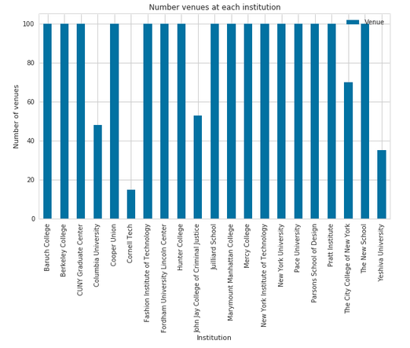
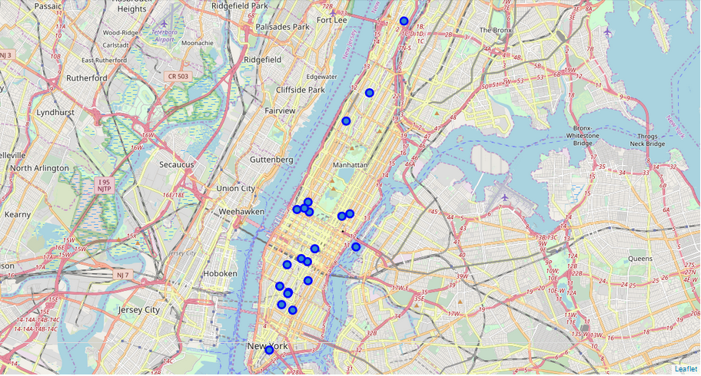
Exploratory Data Analysis
249 unique venue categories
Most universities stopped at the 100 venue limit
Cornell Tech only has 15 venues nearby

Slide 6
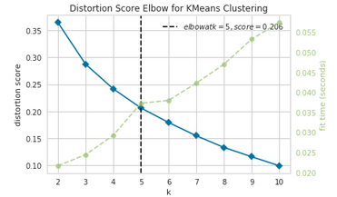
k-means Clustering
Machine learning algorithm
k-means clustering divides the data into k non-overlapping clusters where objects within a cluster are very similar and objects across different cluster are very dissimilar
5 clusters are optimal for the 21 universities

Slide 7
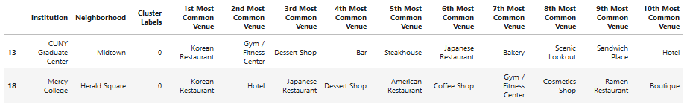
Cluster 1 - Koreatown

Slide 8
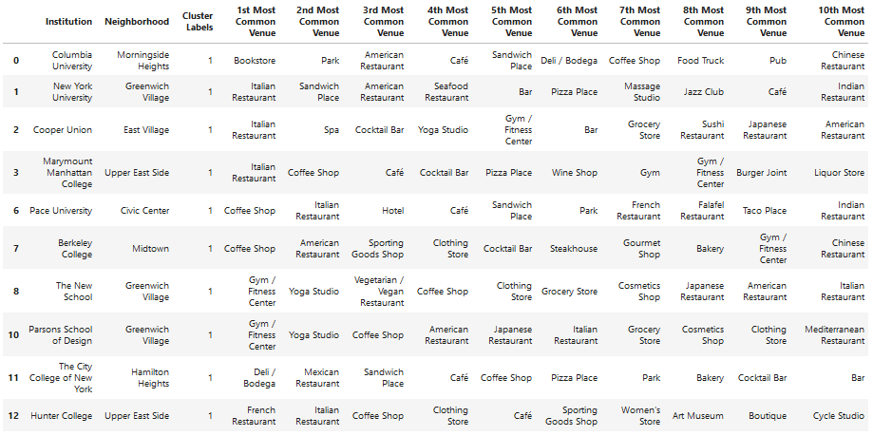
Cluster 2 – Restaurants, Coffee Shops, and Bars Everywhere

Slide 9
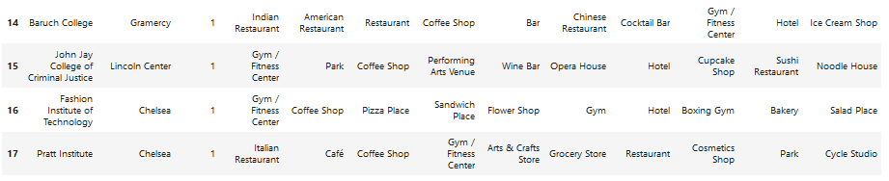
Cluster 2 (cont’d)

Slide 10

Cluster 3 – Enjoying the Outdoors Due to Minimal Options

Slide 11
Cluster 4 – Consumer Stores and Hispanic Community Offerings

Slide 12
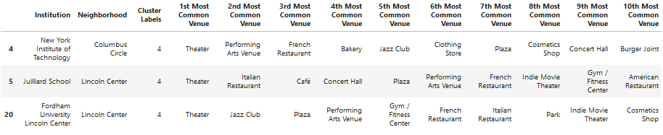
Cluster 5 – Performing Arts Mecca

Slide 13
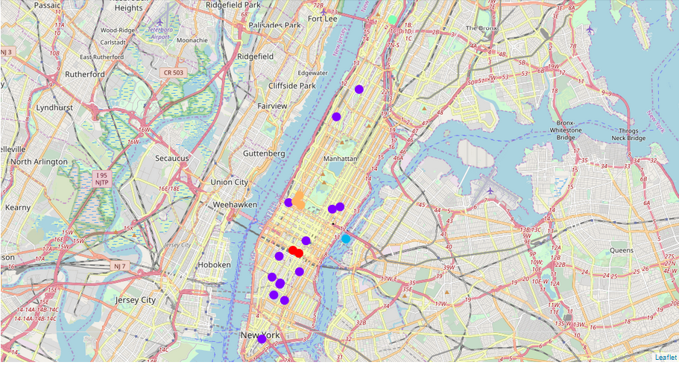
Map showing each university and its associated cluster
Cluster 1 – Red
Cluster 2 – Purple
Cluster 3 – Light Blue
Cluster 4 – Teal
Cluster 5 – Yellow

Slide 14
Summary
The resulting clustering shows clear differences in the venues surrounding 21 of Manhattan’s universities.
The most common venues for 14 of the universities include restaurants, coffee shops, and fitness centers.
Other universities, notable Cornell Tech, lacks surrounding venues.
Other universities, such as CUNY Graduate Center, Mercy College, and Yeshiva University, are in distinct neighborhoods, which are reflected in their common venue categories

